Slide 1


CMR TECHNICAL CAMPUS
UGC(Autonomous)
Accredited by NBA & NAAC with ‘A’ Grade
Approved by AICTE , New Delhi & JNTU, Hyderabad.
Department of Computer Science Engineering
A Mini Project on
EMOTION DETECTION USING TWITTER
DATASETS AND SPACY ALGORITHM
Presented by
CH. Niharika 217R1A0516
P. Nikitha 227R5A0502
A. Shivani 217R1A0501
Under the Guidance of
Mr. M.Madhusudhan (Assistant Professor)

Slide 2
TABLE OF CONTENTS
INTRODUCTION
EXISTING SYSTEM​​
DISADVANTAGES​​
PROPOSED SYSTEM ​​
SYSTEM REQUIREMENTS
​​ADVANTAGES​​
SYSTEM ARCHITECTURE​​
UML DIAGRAM​​S​
MODULES
SAMPLE CODE
RESULTS
CONCLUSION
FUTURE SCOPE
REFERENCES

Slide 3
INTRODUCTION
Emotion Is one of the most valuable parts of human communication , emotion analysis is a type of information extraction process which identifies the emotional
states of a given text.
In the world of today’s social networks, users share their opinions and emotions in their way through different medium like Twitter, Instagram, Facebook, and many more.

Slide 4

The three different deep learning architectures including artificial neural network (ANN), convolutional neural network (CNN) and recurrent neural network (RNN) with long short-term memory (LSTM)
Deep Learning
Recurrent Neural Networks
Convolutional Neural Network
Artificial Neural Networks

Slide 5
EXISTING SYSTEM​
There has been many works in this area for the last couple of years.
The authors created a corpus of Twitter tweets and used corpus annotation study to prepare an annotated corpus. Multi-class SVM kernels were used for learning model.
For features selection Unigrams, Bigrams, Personal, pronouns, adjectives, Word-net Affect emotion lexicon, Word-net Affect emotion and Dependency–parsing features.
They trained four different supervised classifiers, Naïve Bayes (NB), Support Vector Machine (SVM), Maximum Entropy (MaxEn), Artificial Neural Networks (ANN). SVM combined with Principal Component Analysis (PCA) obtains the maximum accuracy.

Slide 6
EXISTING SYSTEM DISADVANTAGES:
1.LESS ACCURACY
2.LOW EFFICIENCY
3.DATA NOISE
4.CONTEXT DEPENDENCE
5.TEMPORAL CHANGES
6.MODEL LIMITATIONS
7.ETHICAL CONSIDERATIONS

Slide 7
PROPOSED SYSTEM ​​
Raw tweets scraped from twitter usually results in a noisy dataset with a lot of useless value.
Tweets have certain exceptional characteristics such as website URL, short form words, retweets, emoticons, person mentions, etc
Therefore, raw twitter data has to be pre-processed to create a dataset which will be easy for different classifiers to generate good results

Slide 8
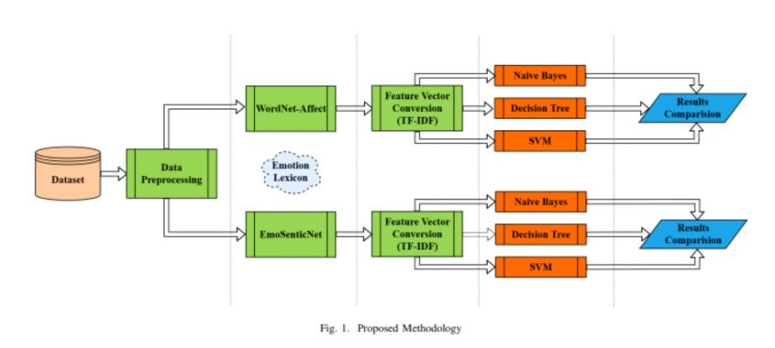
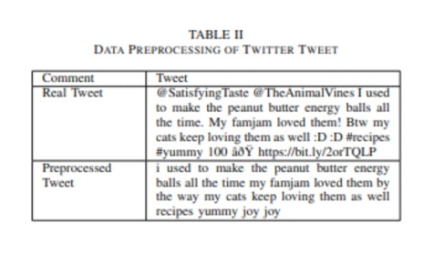

Slide 9
PROPOSED SYSTEM ADVANTAGES:
1.HIGH ACCURACY
2.HIGH EFFICIENCY
3.LARGE VOLUME OF DATA
4.NLP CAPABILITIES
5.CUSTOMIZABILITY
6.PRE-TRAINED MODELS
7.FLEXIBILITY

Slide 10
HARDWARE & SOFTWARE REQUIREMENTS
HARDWARE REQUIRMENTS :
System : i5
Ram : 4 GB.
Hard Disk : 40 GB
SOFTWARE REQUIRMENTS :
Operating system : Windows8 or Above.
Coding Language : python(version 3.7.0)

Slide 11
NOVELITY OF PROJECT
1.Dataset Curations and Enhancements
2.Advanced NLP Techniques
3.Emotion Classification Granularity
4.Real-Time Analysis and Visualization
5.Impact Assessment
6.Ethical Considerations

Slide 12
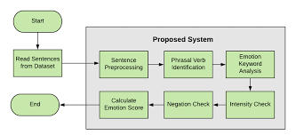
SYSTEM ARCHITECTURE​​

Slide 13
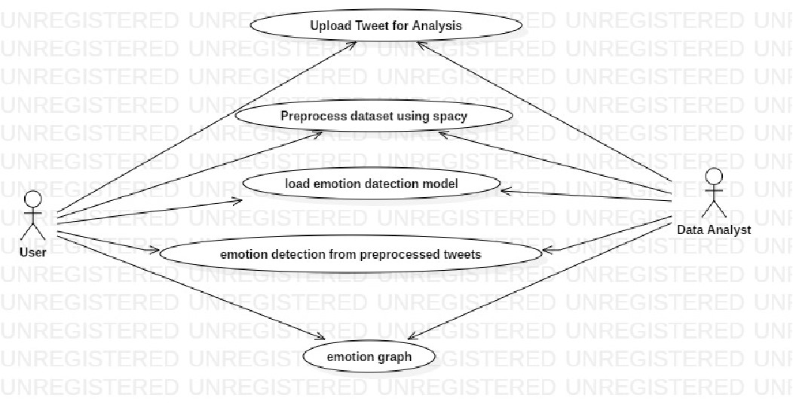
UML DIAGRAM​​S
UseCase Diagram
​

Slide 14
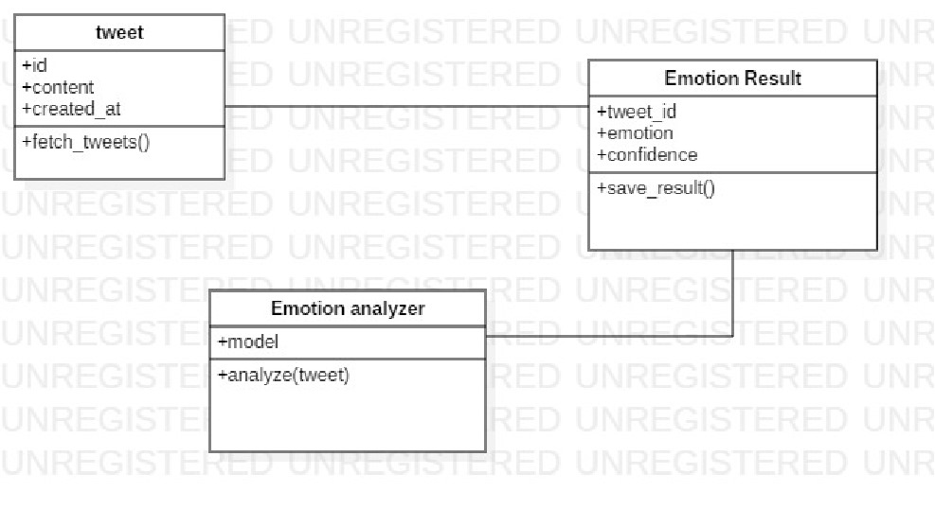
Class Diagram

Slide 15
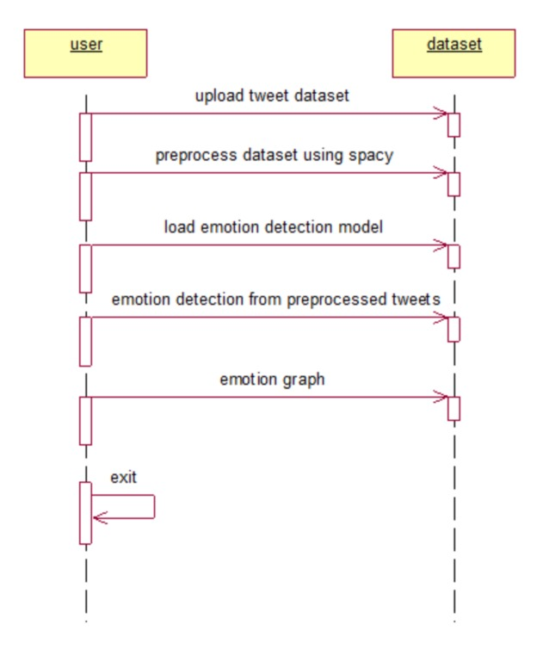
Sequence Diagram

Slide 16
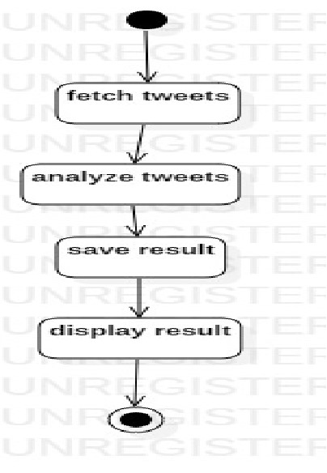
Activity Diagram

Slide 17
MODULES
To implement this project we have designed following modules
Upload Tweets Dataset: using this module we will upload tweets messages to application
Preprocess Dataset using Spacy: using this module we will read each tweets and then apply spacy algorithm to clean and processed tweets
Load Emotion Detection Model: using this module we will load emotion detection machine learning algorithm
Emotion Detection from Processed Tweets: using this module we will apply each processed tweet on machine learning model which will predict emotion from given tweet
Emotion Graph: using this module we will plot emotion graph from all tweets

Slide 18
Algorithm
Twitter dataset
Emotion Detection

Slide 19
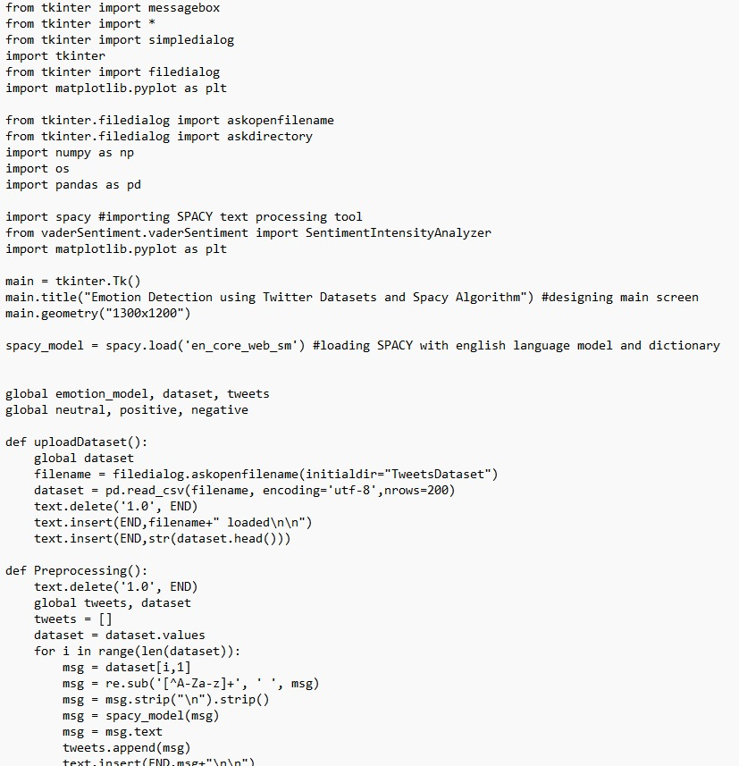
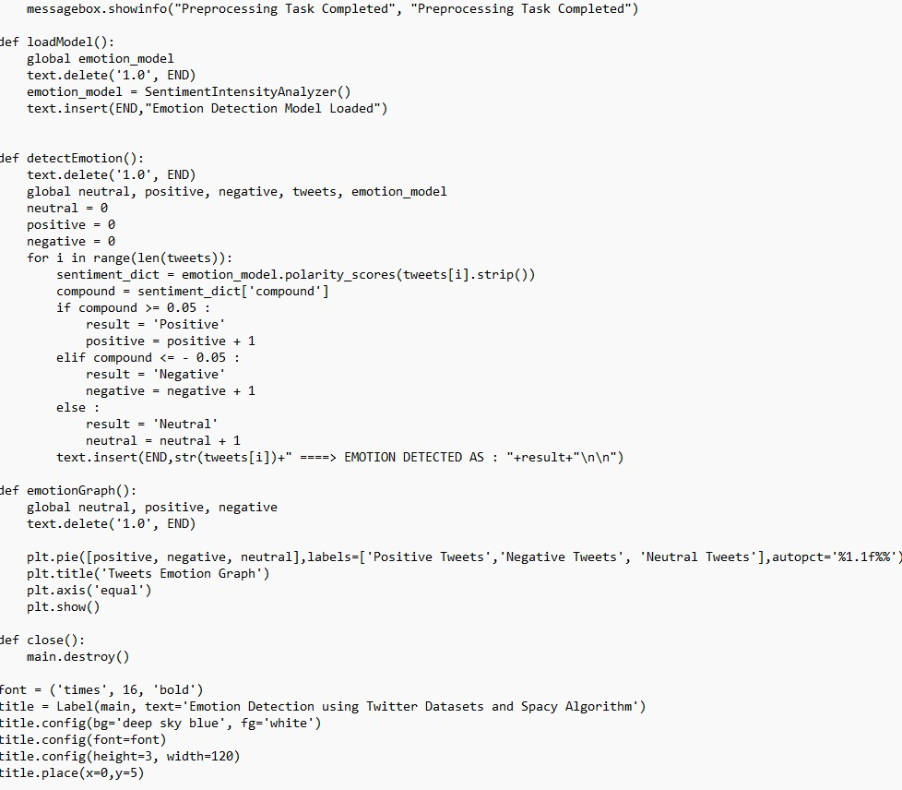
SAMPLE CODE

Slide 20
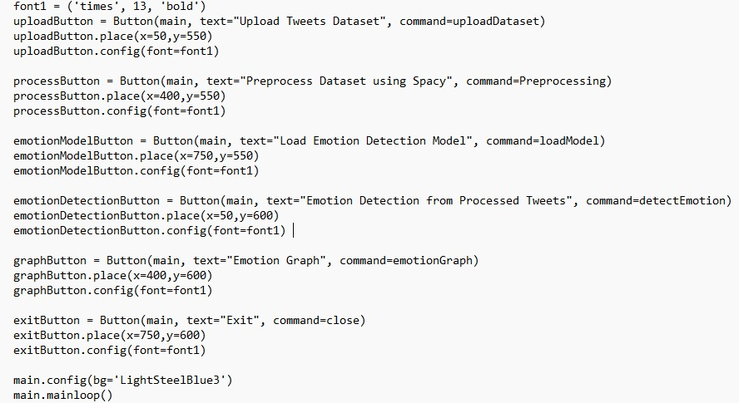

Slide 21
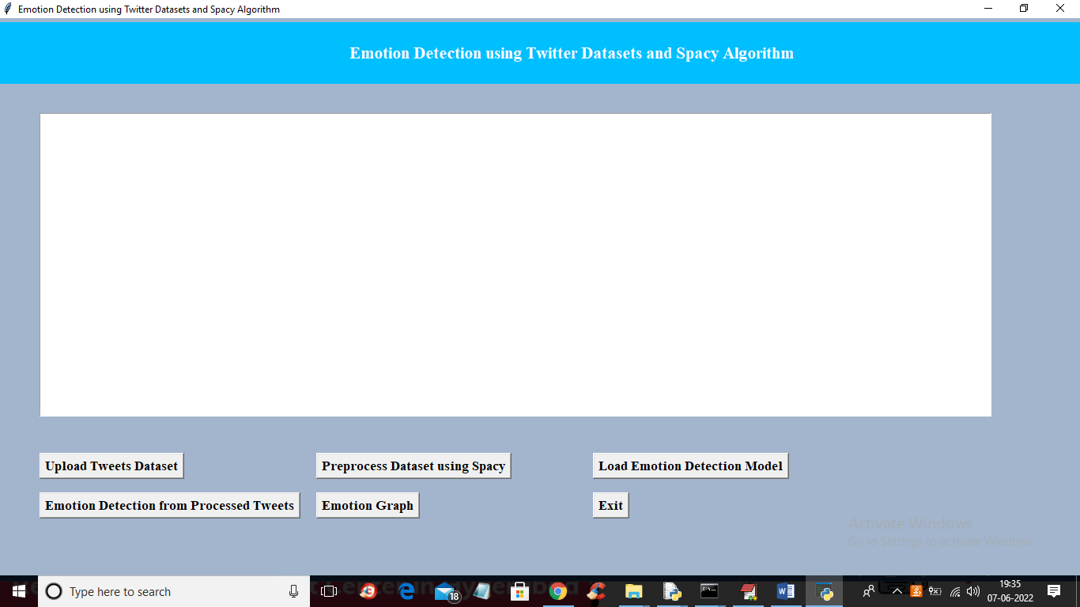
SCREEN SHORTS
To run project double click on ‘run.bat’ file to get below screen
In above screen click on ‘Upload Tweets Dataset’ button to load tweets and get below output

Slide 22
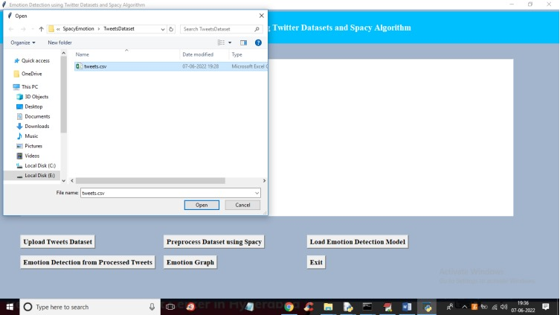
In above screen selecting and uploading tweets dataset and then click on ‘Open’ button to get below output

Slide 23
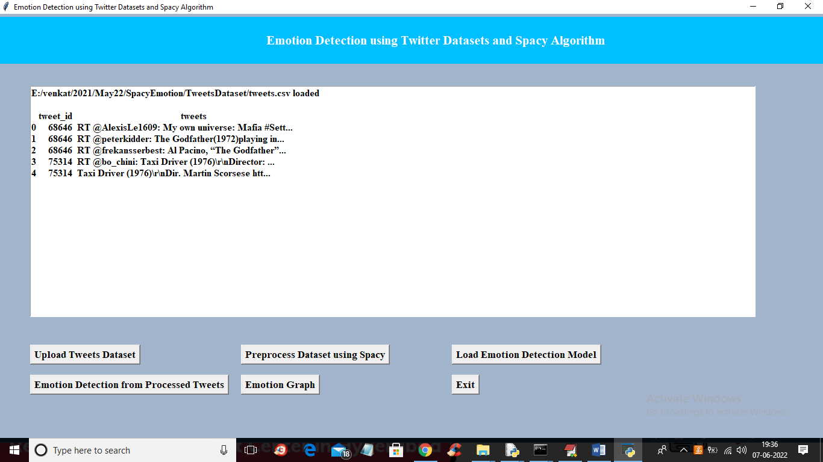
In above screen we can see dataset loaded and tweets contains total unstructured text with stop words and special symbols and now click on ‘Preprocess Dataset using Spacy’ to clean tweets and get below output

Slide 24
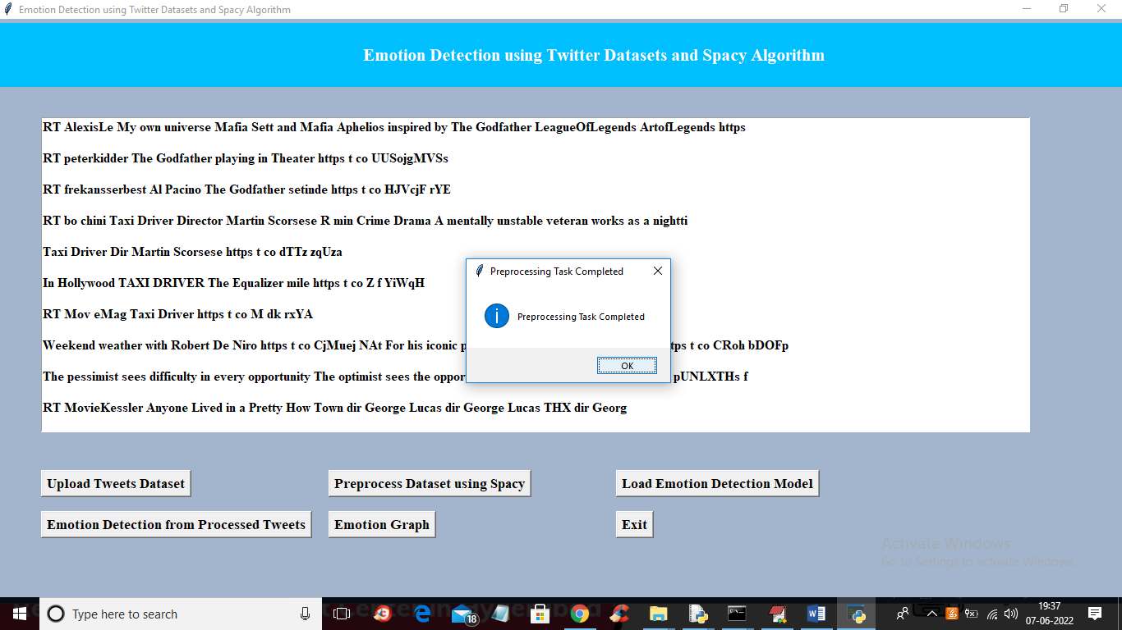
In above screen Preprocessing completed and we can see all tweets contains only text with clean words and now click ‘Ok’ button and then click on ‘Load Emotion Detection Model’ button to load machine learning model for emotion detection and get below output

Slide 25
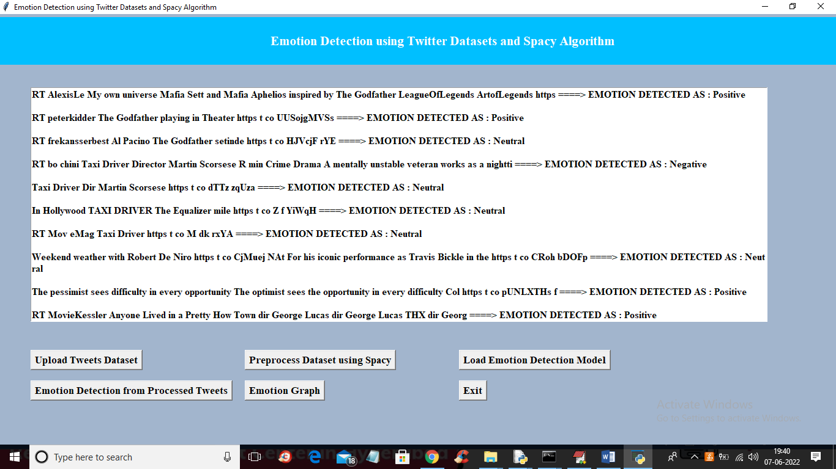
In above screen before arrow symbol =➔ we can see clean tweet messages and after arrow symbol we can see predicted emotion as ‘Positive, Negative or Neutral’ and scroll down above screen to view all messages

Slide 26
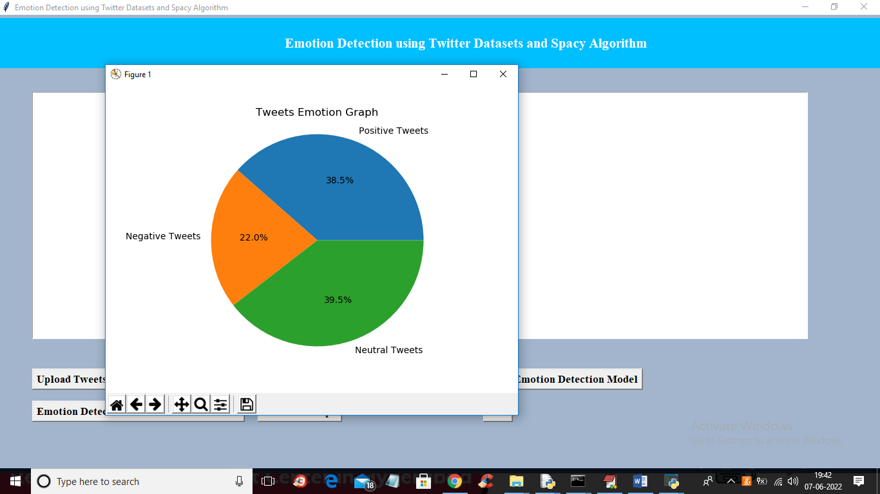
RESULT:
In above screen we can see all tweets with emotion and now click on ‘Emotion Graph’ to know tweets percentage in each emotion

Slide 27
CONCLUSION :
Detecting emotion from text is a challenging work and most of the research works have some kind limitations most importantly, language ambiguity, multiple emotion bearing text, text which does not contain any emotion words etc.
The EmoSenticNet outperforms WordNet-Affect by a great margin
In the future, we will introduce Deep Learning techniques to identify emotion detection on this dataset.

Slide 28
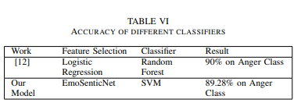

Slide 29
FUTURE SCOPE
In the future, we will introduce Deep Learning techniques to identify emotion detection on this data set.
The software can be developed further to include lot of modules because the proposed system is developed on the view of future.
We can connect to other data bases by including them

Slide 30
REFERENCES
[1] R. Hirat and N. Mittal, “A Survey On Emotion Detection Techniques using Text in Blogposts,” International Bulletin of Mathematical Research, vol. 2, no. 1, pp. 180–187, 2015.
[2] R. Sawyer and G.-M. Chen, “The Impact of Social Media on Intercultural Adaptation,” 2012.
[3] S. Mohammad, F. Bravo-Marquez, M. Salameh, and S. Kiritchenko, “Semeval-2018 Task 1: Affect in Tweets,” in Proceedings of The 12th International Workshop on Semantic Evaluation, 2018, pp. 1–17.

Slide 31

Thank You!

